Slide 1
Teradata CoE
Teradata Lab Course
CONTENTS :
1) The Where Clause
2) Sample
3) Set Operators functions
4) Statistical Aggregate Functions
5) Stored Procedure Functions
6) Sub Query Functions

Slide 2
Teradata CoE
Teradata Lab Course
The WHERE Clause

Slide 3
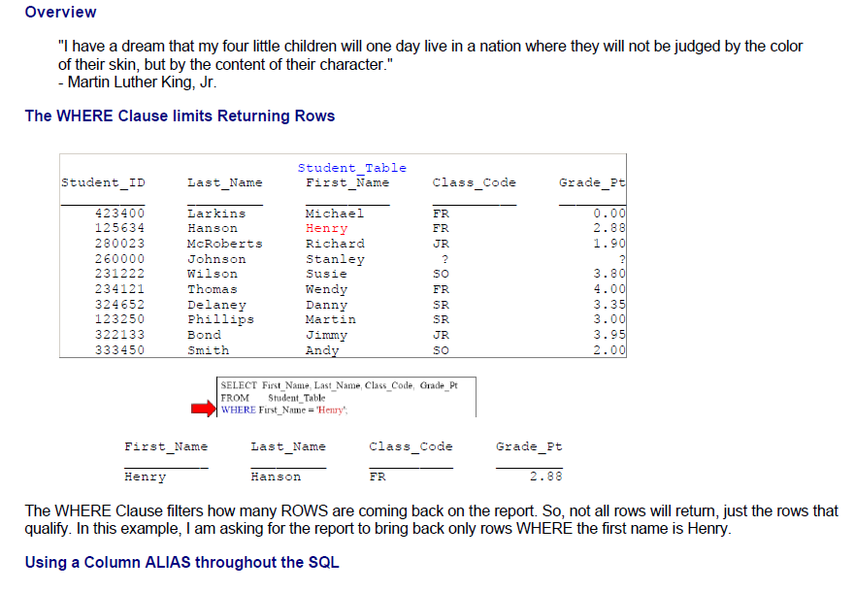
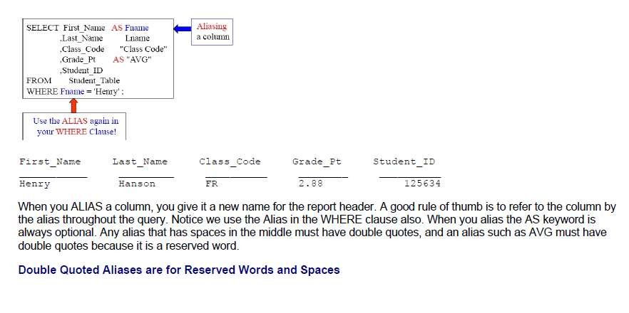
Teradata CoE
Teradata Lab Course
The WHERE Clause

Slide 4
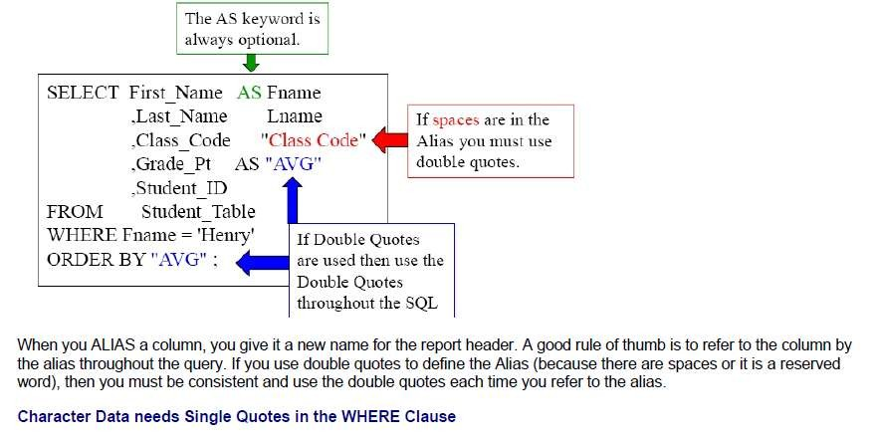
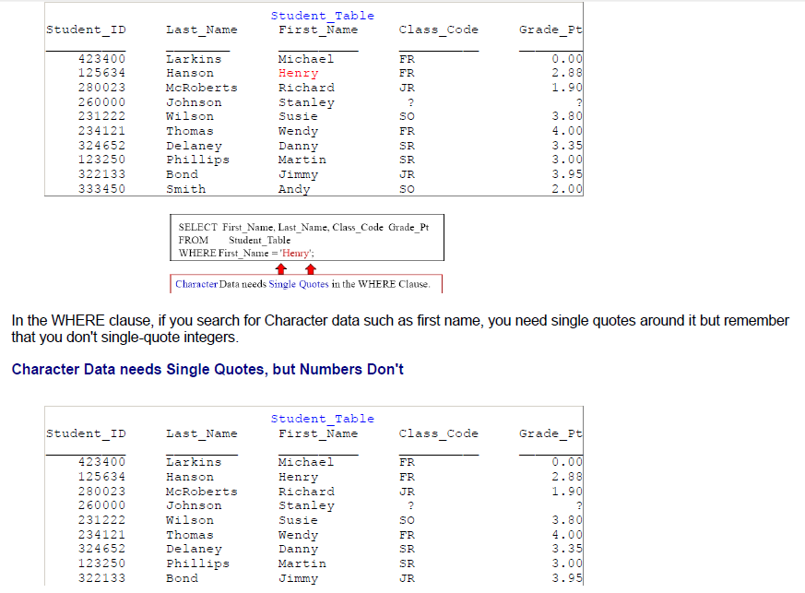
Teradata CoE
Teradata Lab Course

Slide 5
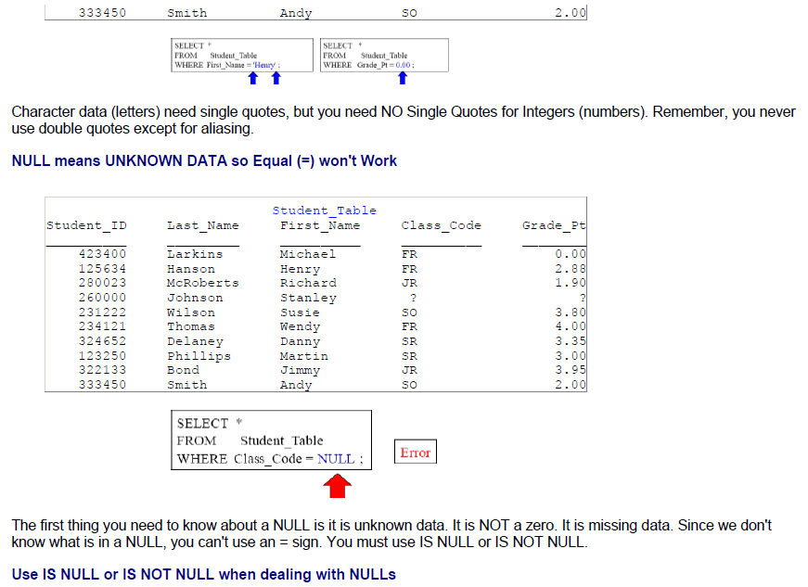
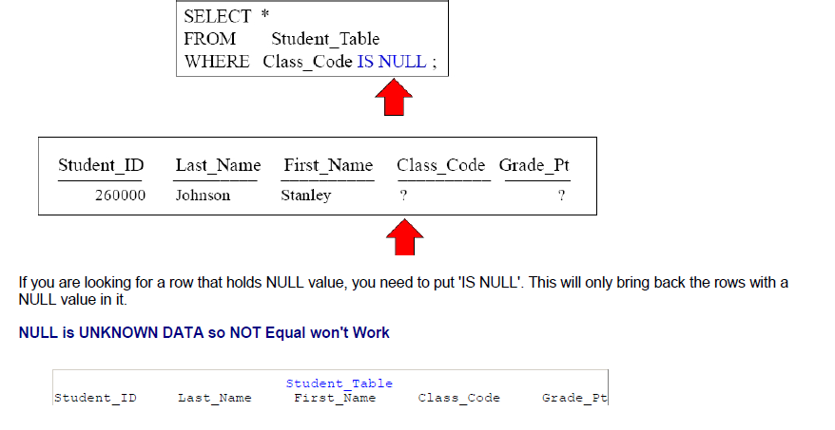
Teradata CoE
Teradata Lab Course

Slide 6
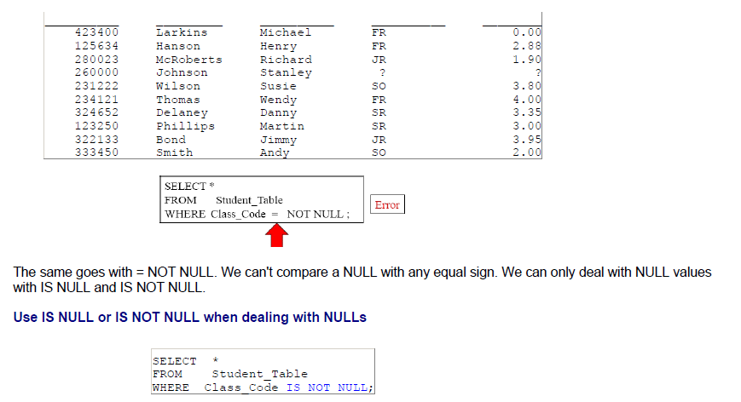
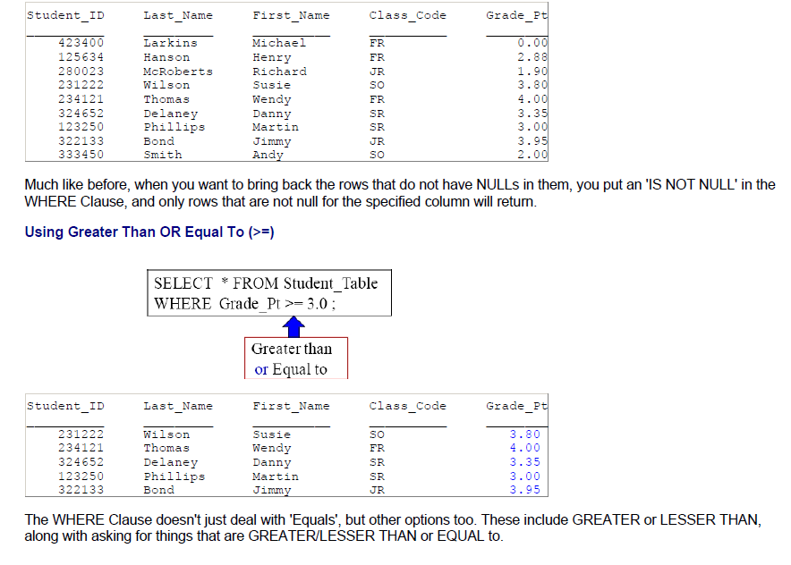
Teradata CoE
Teradata Lab Course

Slide 7
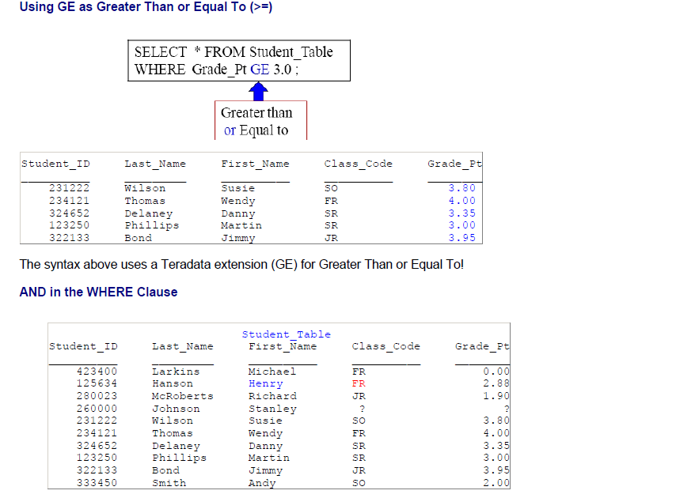
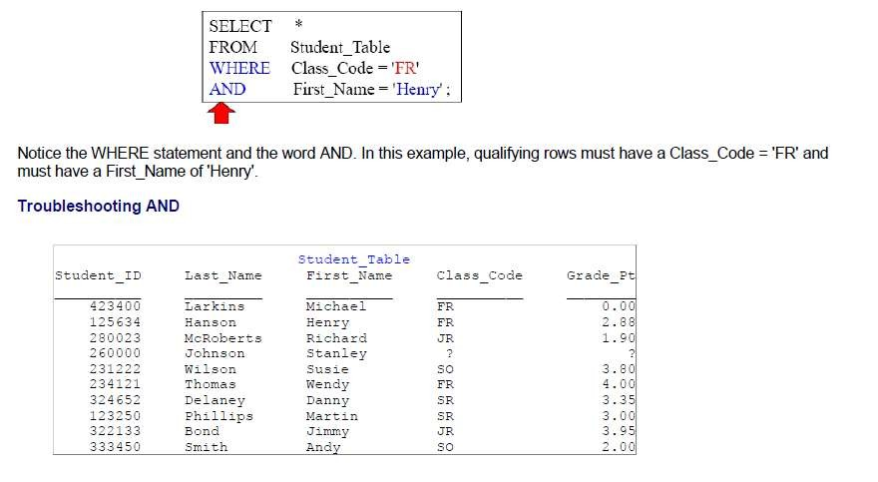
Teradata CoE
Teradata Lab Course

Slide 8
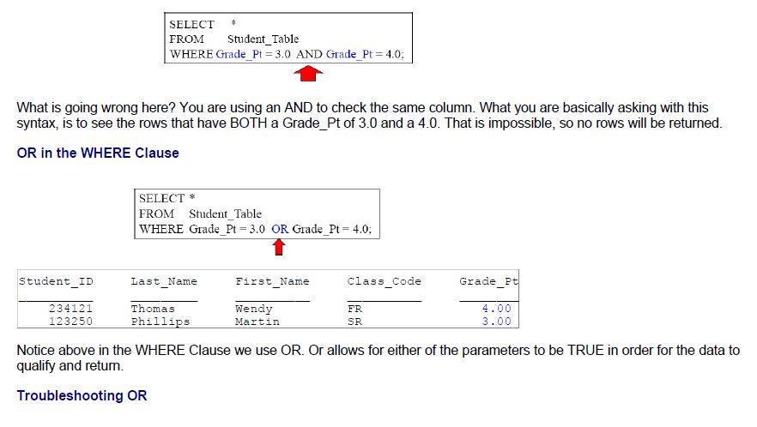
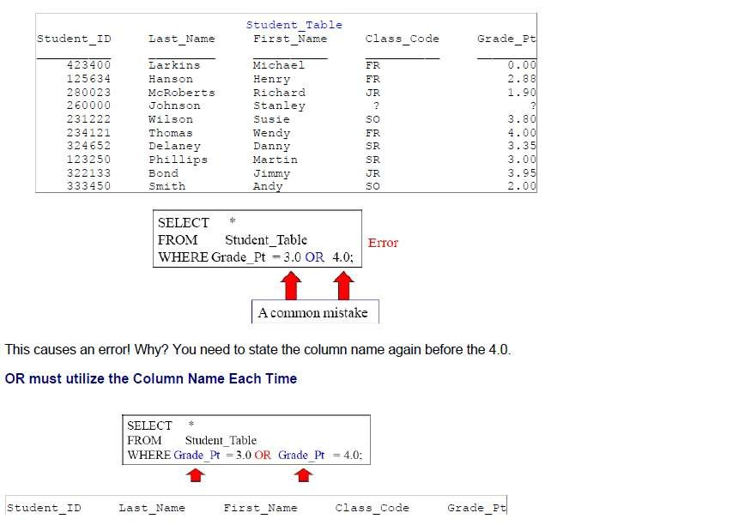
Teradata CoE
Teradata Lab Course

Slide 9
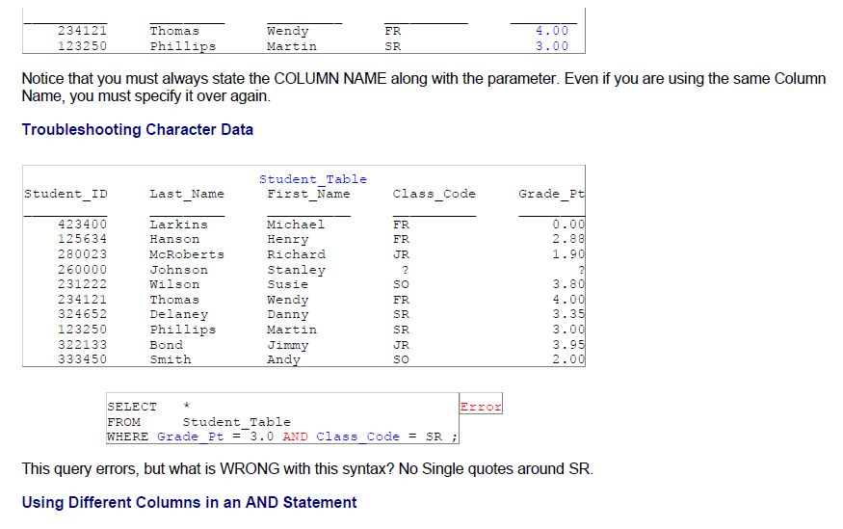
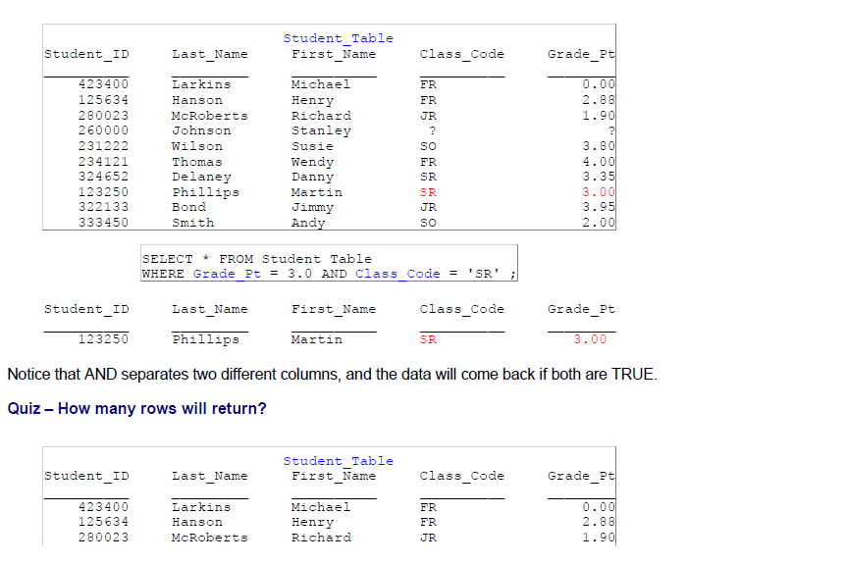
Teradata CoE
Teradata Lab Course

Slide 10
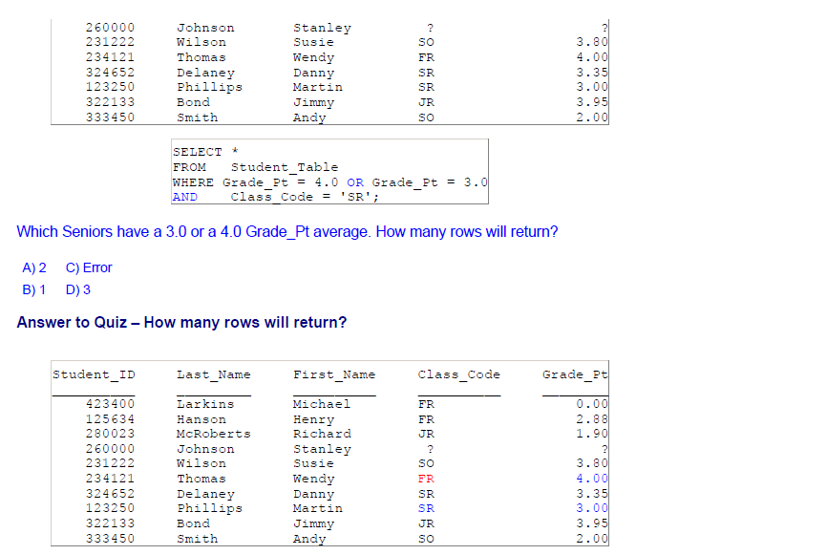
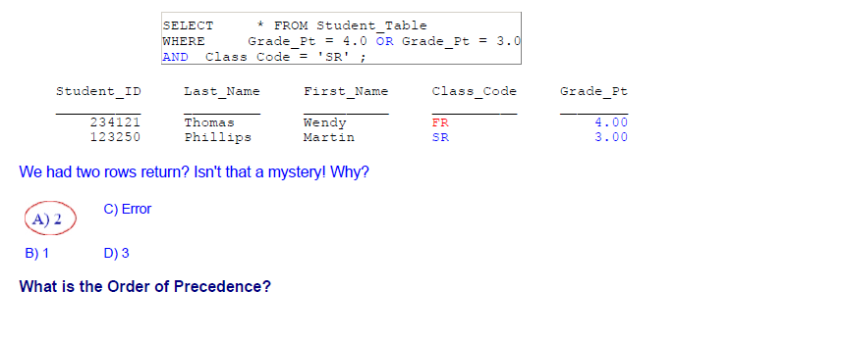
Teradata CoE
Teradata Lab Course

Slide 11
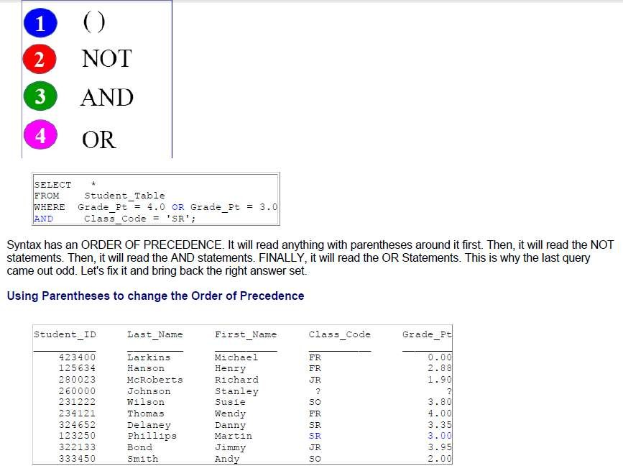
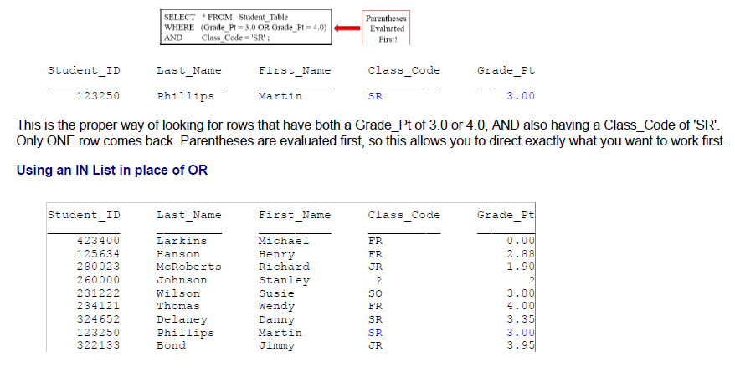
Teradata CoE
Teradata Lab Course

Slide 12
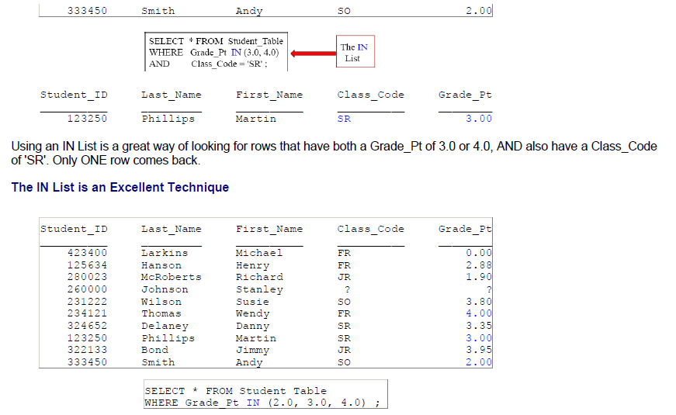
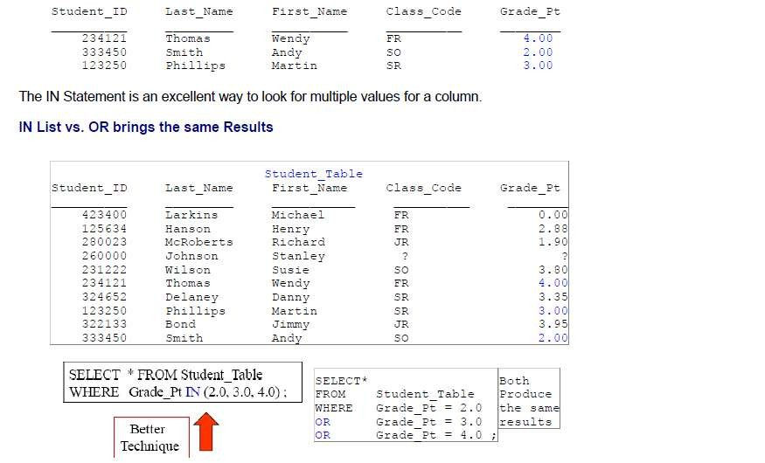
Teradata CoE
Teradata Lab Course

Slide 13
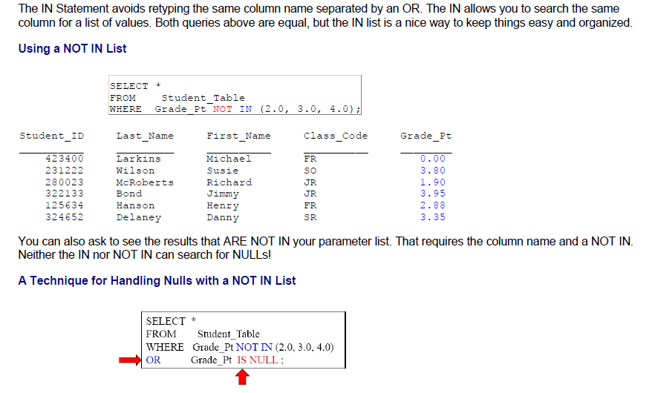
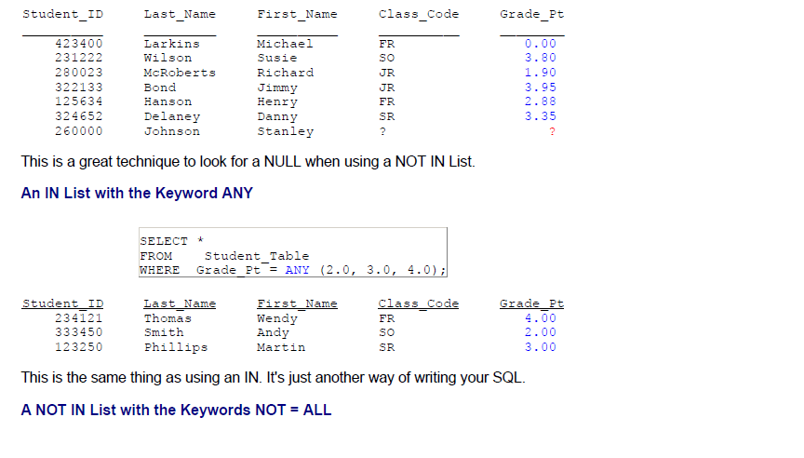
Teradata CoE
Teradata Lab Course

Slide 14
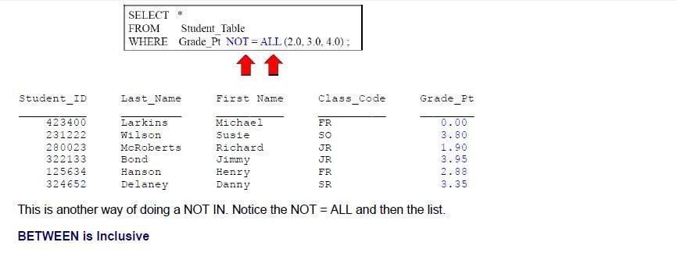
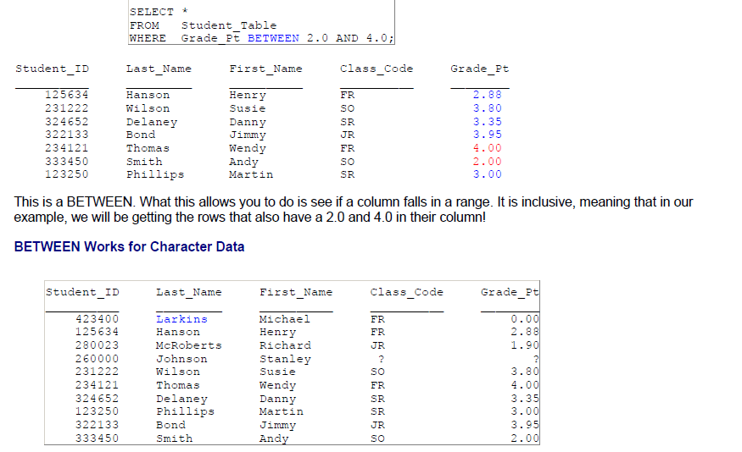
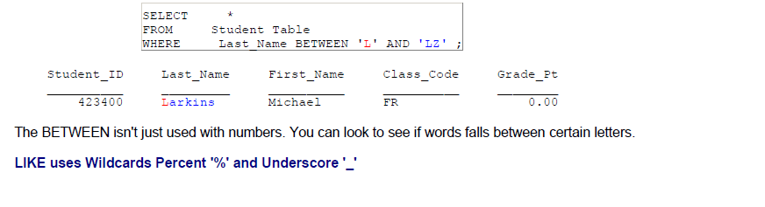
Teradata CoE
Teradata Lab Course

Slide 15
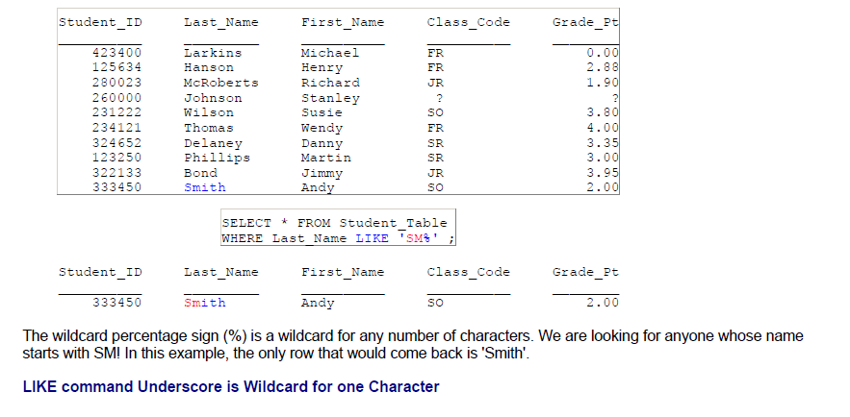
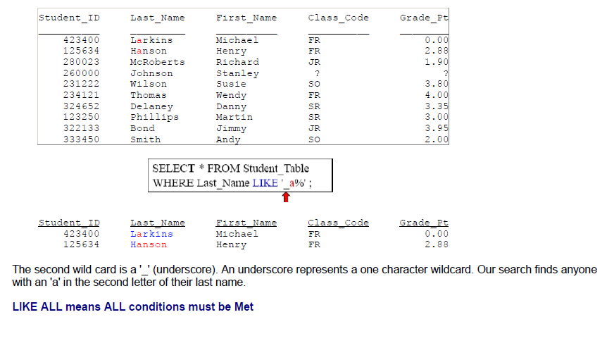
Teradata CoE
Teradata Lab Course

Slide 16
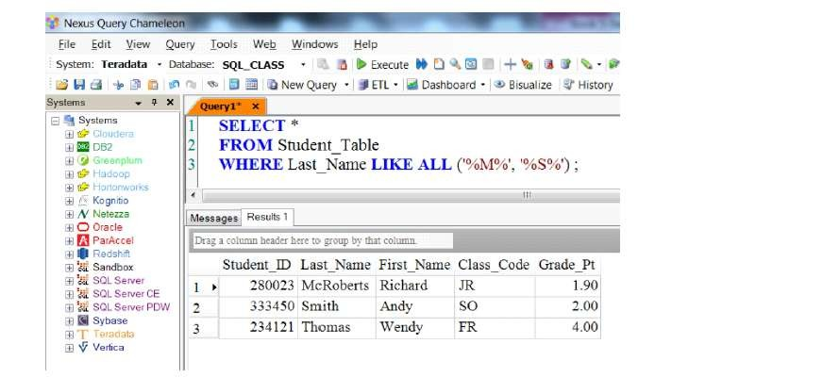
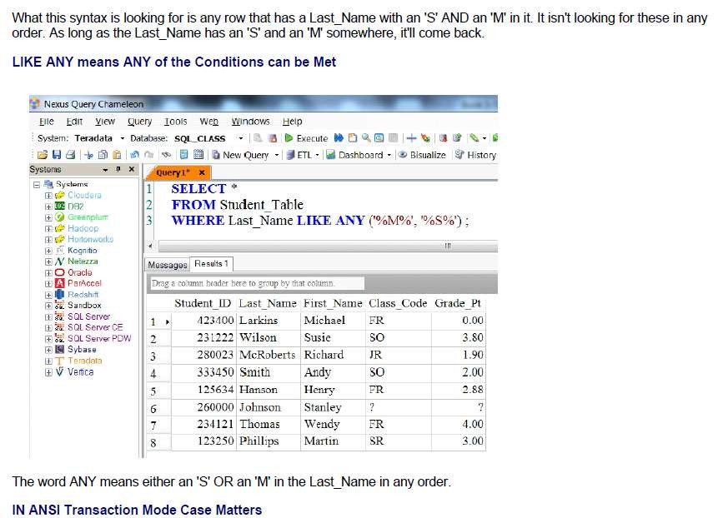
Teradata CoE
Teradata Lab Course

Slide 17
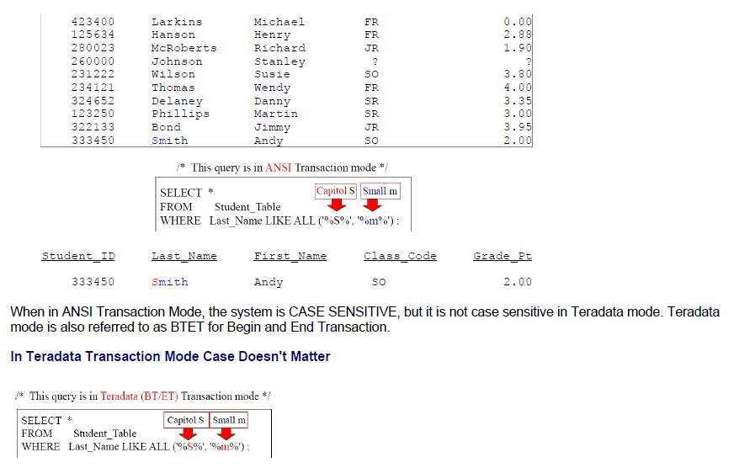
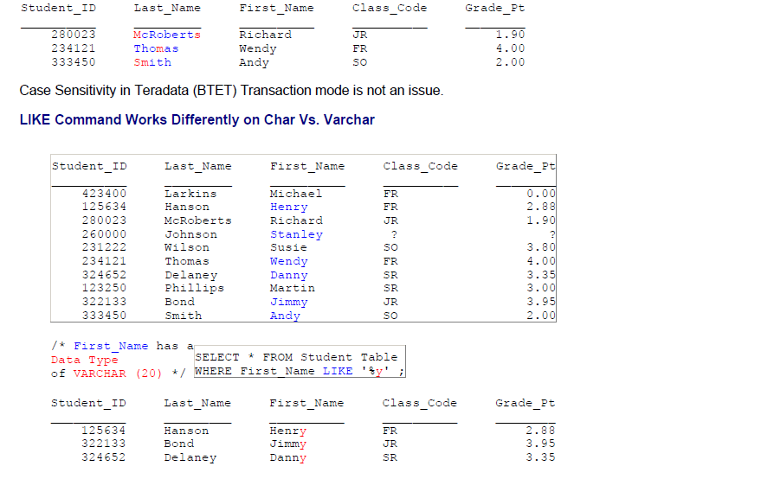
Teradata CoE
Teradata Lab Course

Slide 18
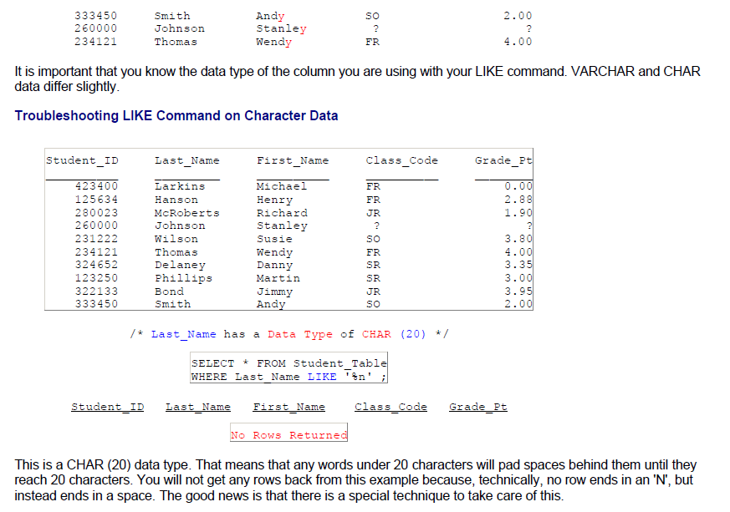
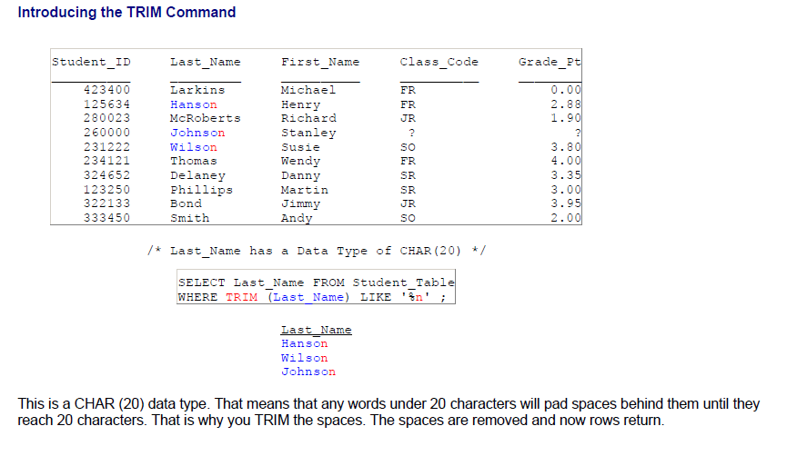
Teradata CoE
Teradata Lab Course

Slide 19
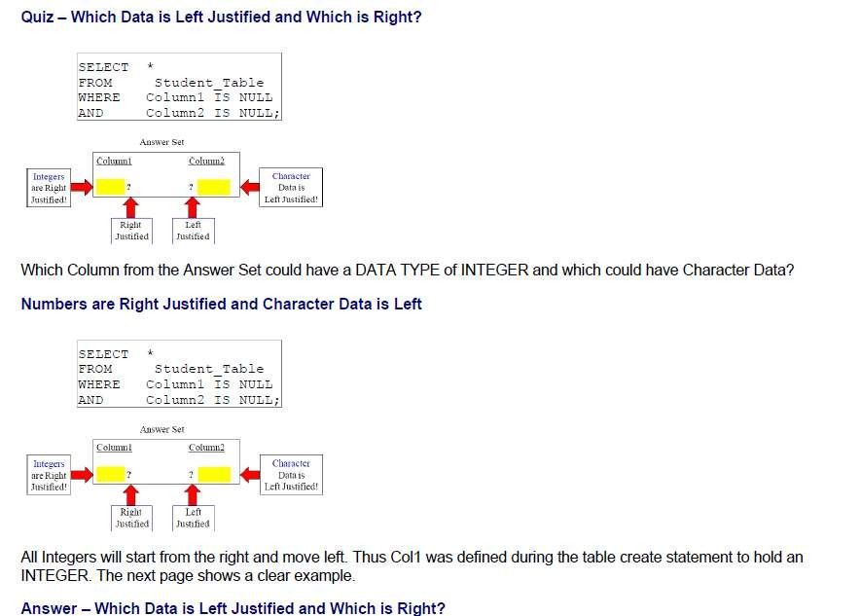
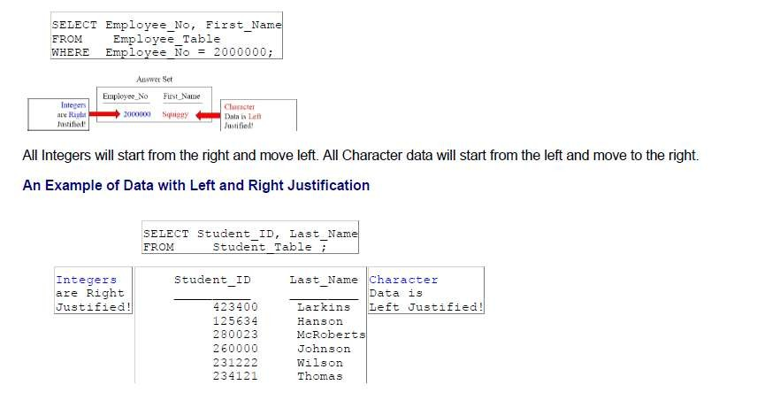
Teradata CoE
Teradata Lab Course

Slide 20
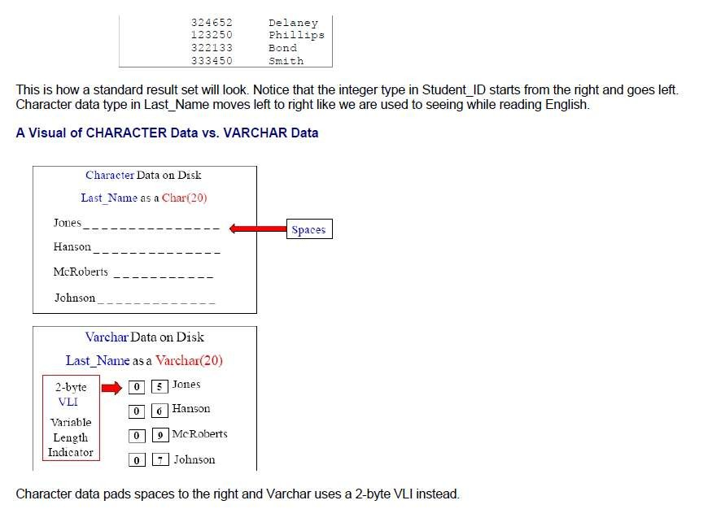
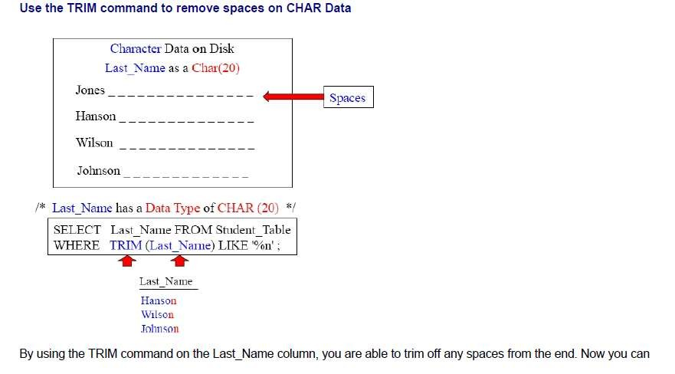
Teradata CoE
Teradata Lab Course

Slide 21
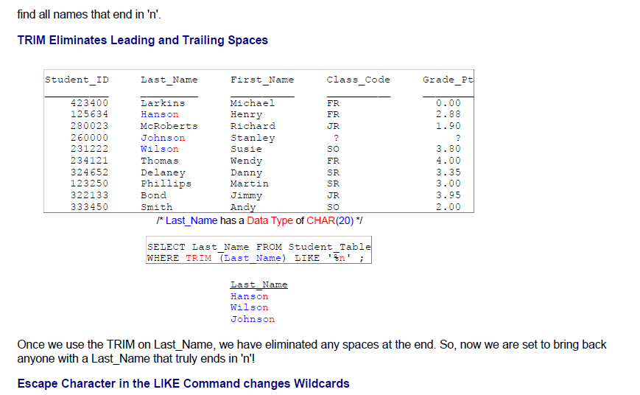
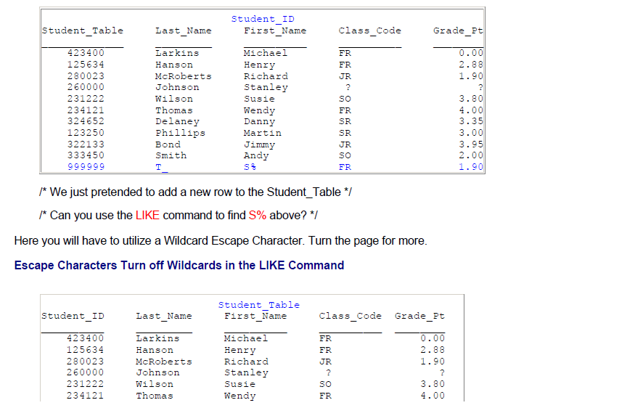
Teradata CoE
Teradata Lab Course

Slide 22
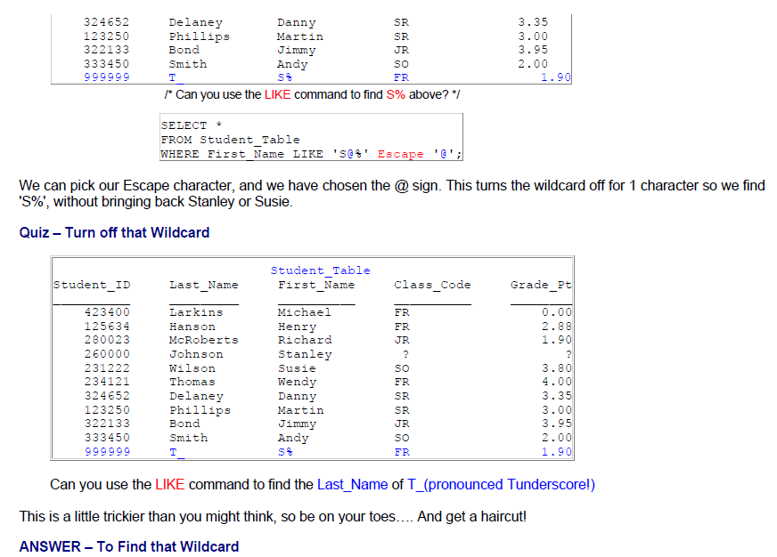
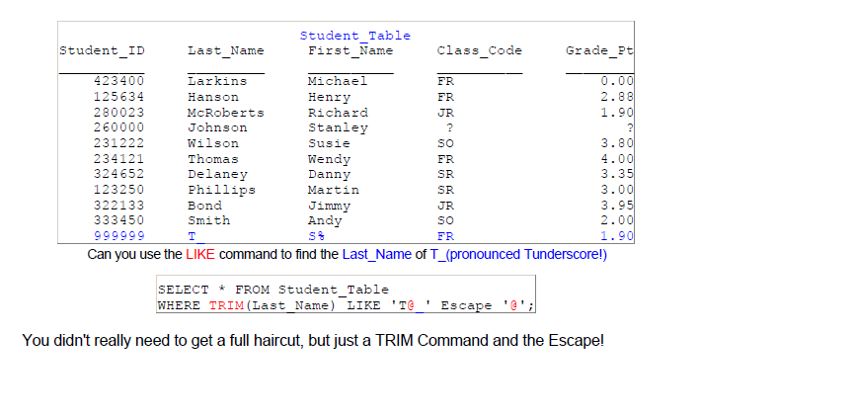
Teradata CoE
Teradata Lab Course

Slide 23
Teradata CoE
Teradata Lab Course
Sample

Slide 24
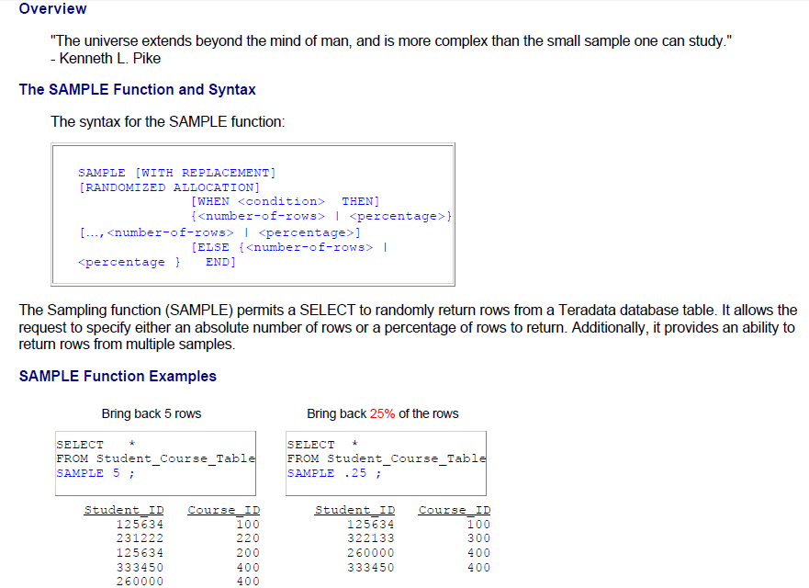
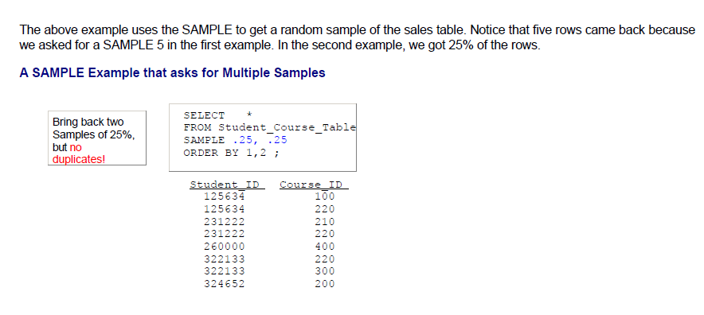
Teradata CoE
Teradata Lab Course
Sample

Slide 25
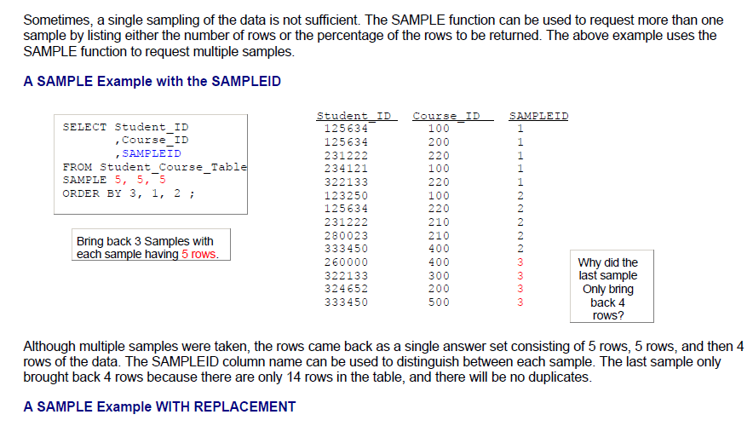
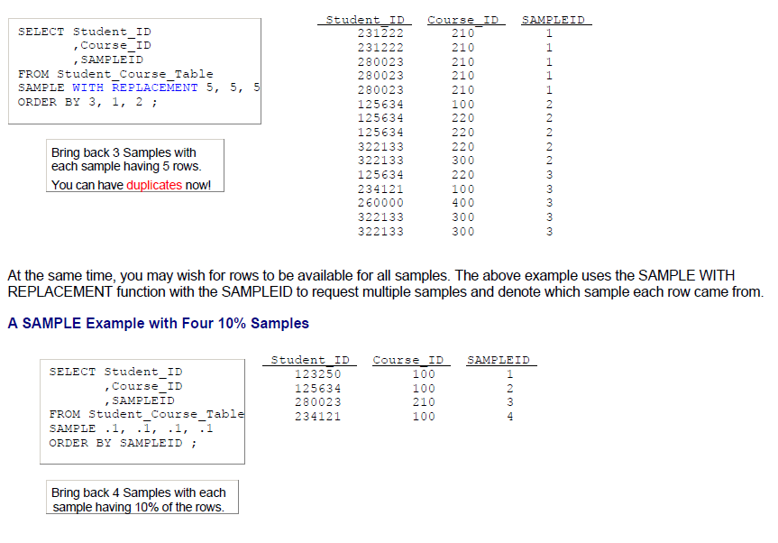
Teradata CoE
Teradata Lab Course

Slide 26
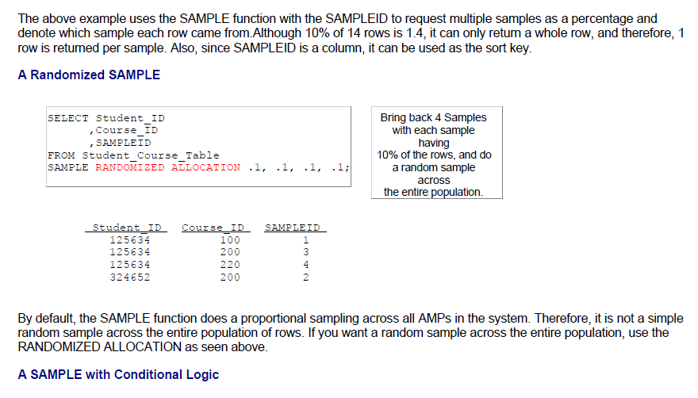
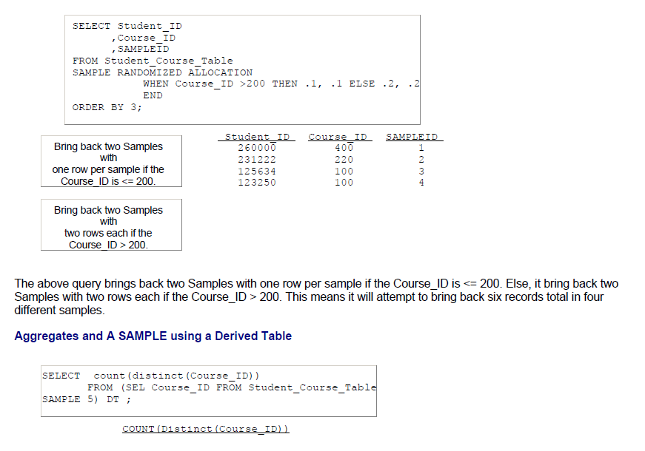
Teradata CoE
Teradata Lab Course

Slide 27
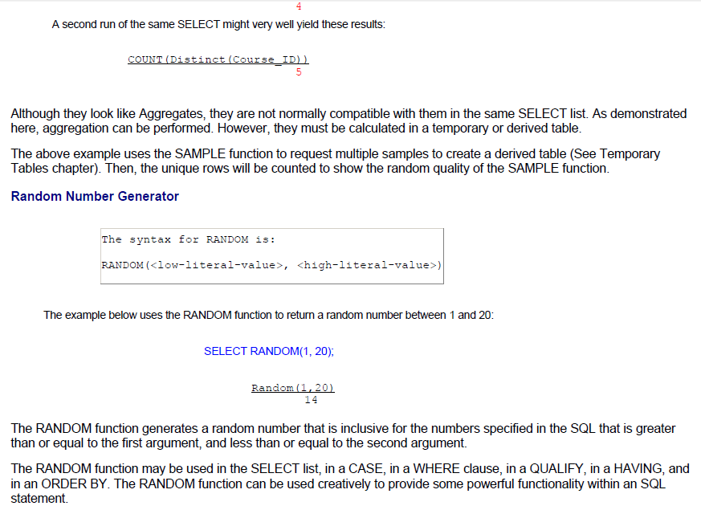
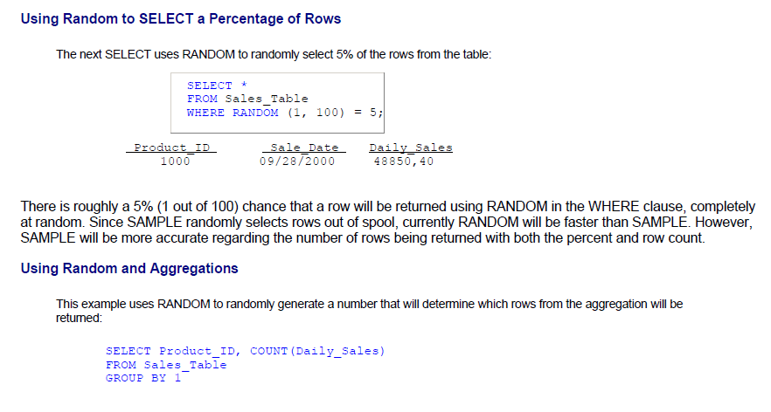
Teradata CoE
Teradata Lab Course

Slide 28
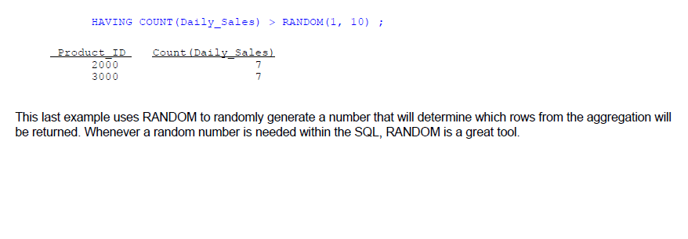
Teradata CoE
Teradata Lab Course

Slide 29
Teradata CoE
Teradata Lab Course
Set
Operators Functions

Slide 30


Teradata CoE
Teradata Lab Course
Set Operators Functions

Slide 31


Teradata CoE
Teradata Lab Course

Slide 32


Teradata CoE
Teradata Lab Course

Slide 33


Teradata CoE
Teradata Lab Course

Slide 34


Teradata CoE
Teradata Lab Course

Slide 35


Teradata CoE
Teradata Lab Course

Slide 36


Teradata CoE
Teradata Lab Course

Slide 37


Teradata CoE
Teradata Lab Course

Slide 38


Teradata CoE
Teradata Lab Course

Slide 39


Teradata CoE
Teradata Lab Course

Slide 40


Teradata CoE
Teradata Lab Course

Slide 41


Teradata CoE
Teradata Lab Course

Slide 42
Teradata CoE
Teradata Lab Course
Statistical
Aggregate Functions

Slide 43


Teradata CoE
Teradata Lab Course
Statistical Aggregate Functions

Slide 44


Teradata CoE
Teradata Lab Course

Slide 45


Teradata CoE
Teradata Lab Course

Slide 46


Teradata CoE
Teradata Lab Course

Slide 47


Teradata CoE
Teradata Lab Course

Slide 48



Teradata CoE
Teradata Lab Course

Slide 49



Teradata CoE
Teradata Lab Course

Slide 50


Teradata CoE
Teradata Lab Course

Slide 51



Teradata CoE
Teradata Lab Course

Slide 52


Teradata CoE
Teradata Lab Course

Slide 53



Teradata CoE
Teradata Lab Course

Slide 54


Teradata CoE
Teradata Lab Course

Slide 55

Teradata CoE
Teradata Lab Course

Slide 56
Teradata CoE
Teradata Lab Course
Stored
Procedure Functions

Slide 57

Teradata CoE
Teradata Lab Course
Stored Procedure Functions

Slide 58


Teradata CoE
Teradata Lab Course

Slide 59


Teradata CoE
Teradata Lab Course

Slide 60

Teradata CoE
Teradata Lab Course

Slide 61


Teradata CoE
Teradata Lab Course

Slide 62


Teradata CoE
Teradata Lab Course

Slide 63


Teradata CoE
Teradata Lab Course

Slide 64

Teradata CoE
Teradata Lab Course

Slide 65
Teradata CoE
Teradata Lab Course
Sub-query Functions

Slide 66


Teradata CoE
Teradata Lab Course
Sub-query Functions

Slide 67


Teradata CoE
Teradata Lab Course

Slide 68


Teradata CoE
Teradata Lab Course

Slide 69


Teradata CoE
Teradata Lab Course

Slide 70


Teradata CoE
Teradata Lab Course

Slide 71


Teradata CoE
Teradata Lab Course

Slide 72


Teradata CoE
Teradata Lab Course

Slide 73

Teradata CoE
Teradata Lab Course

Slide 74

Teradata CoE
Teradata Lab Course

Slide 75

Teradata CoE
Teradata Lab Course

Slide 76


Teradata CoE
Teradata Lab Course

Slide 77


Teradata CoE
Teradata Lab Course

Slide 78


Teradata CoE
Teradata Lab Course

Slide 79


Teradata CoE
Teradata Lab Course

Slide 80


Teradata CoE
Teradata Lab Course

Slide 81


Teradata CoE
Teradata Lab Course

Slide 82


Teradata CoE
Teradata Lab Course

Slide 83


Teradata CoE
Teradata Lab Course

Slide 84


Teradata CoE
Teradata Lab Course

Slide 85


Teradata CoE
Teradata Lab Course

Slide 86


Teradata CoE
Teradata Lab Course

Slide 87
Teradata CoE
Teradata Lab Course

Slide 88
Teradata CoE
Teradata Lab Course

